Slide 1



i
BY – ASHISH KUMAR SRIVASTAVA

Slide 2

INTRODUCTION
This project is based on the analysis of a Social Media database using MS SQL SERVER.
Through my SQL queries I have shown a clear cut description of connections and inter relation between different activities on social media.
I have used CREATE, INSERT commands along with various DATA TYPES and SQL Constraints to create 13 different tables.
Aggregated the data by using GROUP BY, JOINS, Sub Queries and Windows Function to generate valuable insights into user engagements.
Implemented advanced functions such as CTE, VIEWS and TRIGGER to showcase content trends and performance metrics, leading to improved social media marketing strategies and content optimization.
ashishsrivastav1999@gmail.com

Slide 3
TABLES
‘comments’ – It contains data of users who commented on posts.
‘comment_like’ – It contains data of users who liked comments on posts.
‘bookmarks’ – It contains data of bookmarked posts.
‘follows’ – It contains data of users and their followers and whom they follow.
‘hashtag_follow’ – It contains data of users who used hashtags.
‘hashtags’ – It contains data of hashtags and their respective ids.
‘login’ – It contains data of login id and login time.
‘photos’ – It contains data of uploaded photos along with their ids.
‘post’ – It contains data of user’s posts along with their post ids.
‘post_likes’ – It contains data of user’s who liked the posts.
‘post_tags’ – It contains data of tagged users in posts.
‘videos’ – It contains data of uploaded videos along with their ids.
‘users’ - It contains data od users like id, name, email, bio, etc.
ashishsrivastav1999@gmail.com

Slide 4
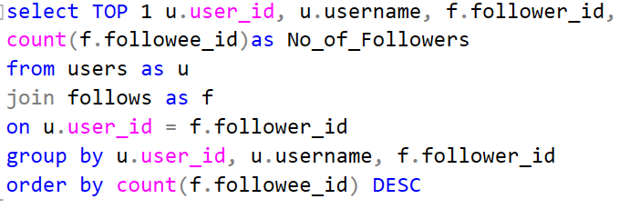

QUERY 1
Q. Find the user with the most followers.
This query identifies the user who has the largest number of followers. It returns the user's ID, username, and the count of their followers.
ashishsrivastav1999@gmail.com

Slide 5
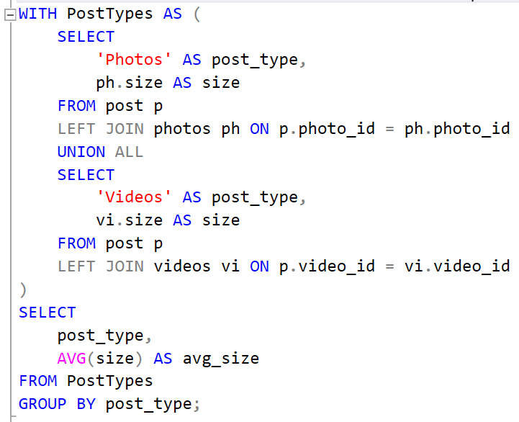
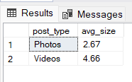
QUERY 2
Q. Calculate the average post size by post type (photo or video).
This query calculates the average size of posts based on their type, which can be either "Photo" or "Video." It provides insights into the average size for each post type.
ashishsrivastav1999@gmail.com

Slide 6
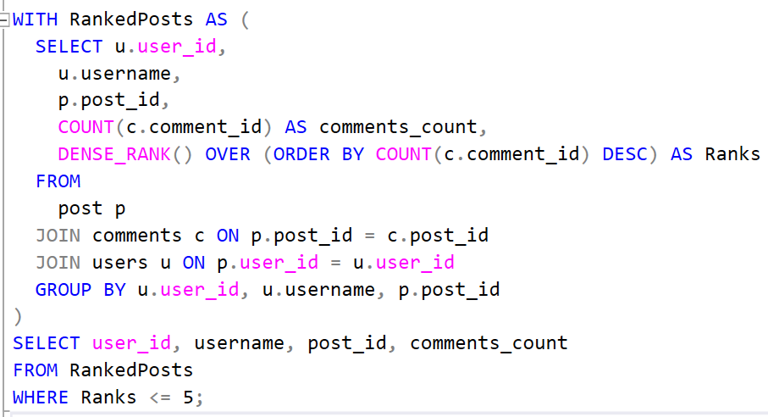
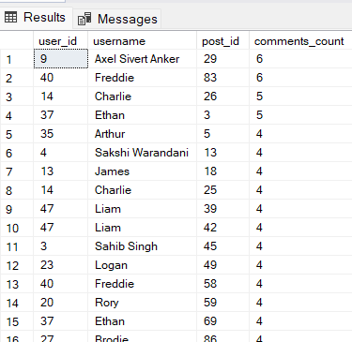
QUERY 3
Q. List the top 5 posts with the most comments and their user owners.
This query lists the top 5 posts with the highest number of comments and their respective user owners. It's useful for identifying popular posts and their creators.
ashishsrivastav1999@gmail.com

Slide 7
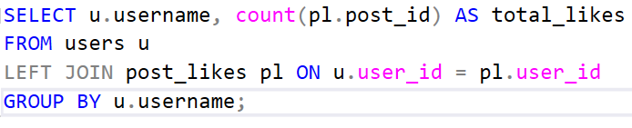
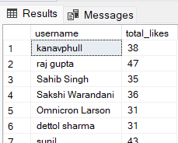
QUERY 4
Q. Calculate the total number of likes on posts by each user
This query calculates the total number of likes received by each user on their posts. It helps in understanding which users receive the most likes.
ashishsrivastav1999@gmail.com

Slide 8
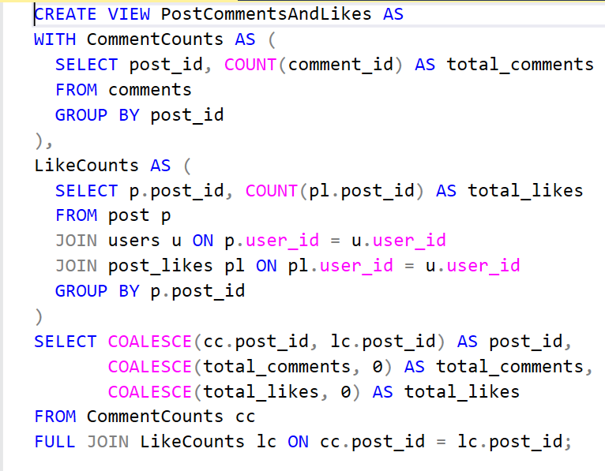

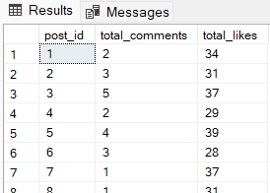
QUERY 5
Q. Create a view to display the total number of comments and likes for each post
This query creates a view that displays the combined number of comments and likes for each post. It's useful for easily accessing this information in the future.
ashishsrivastav1999@gmail.com

Slide 9
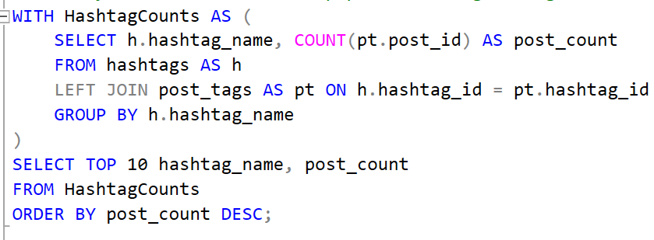
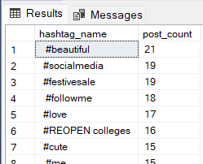
QUERY 6
Q. List the 10 most popular hashtags along with the number of posts they are used in
This query identifies and lists the top 10 most popular hashtags and the number of posts they are associated with. It's helpful for tracking trending topics.
ashishsrivastav1999@gmail.com

Slide 10
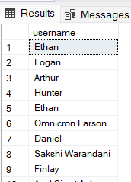
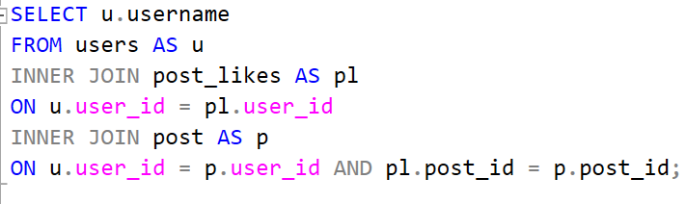
QUERY 7
Q. List the users who have liked their own posts
This query identifies users who have liked their own posts. It can be useful for monitoring self-liking behavior.
ashishsrivastav1999@gmail.com

Slide 11
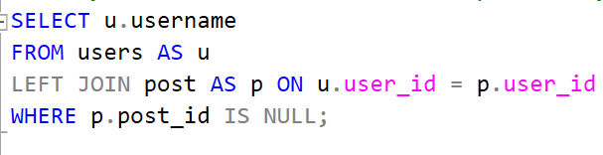
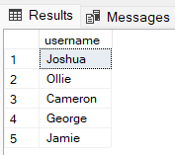
QUERY 8
Q. Find users who have not posted any photos or videos
This query finds users who have not uploaded any photos or videos. It's a way to identify users who haven't shared multimedia content.
ashishsrivastav1999@gmail.com

Slide 12
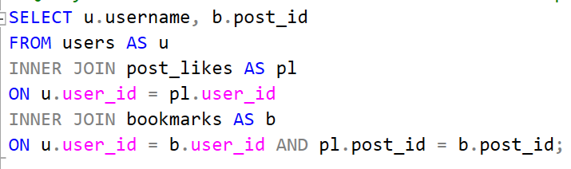
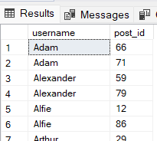
QUERY 9
Q. Find users who have bookmarked the same post that they liked
This query identifies users who have both liked and bookmarked the same posts. It's helpful for understanding user engagement with posts.
ashishsrivastav1999@gmail.com

Slide 13
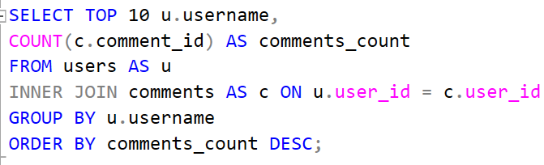
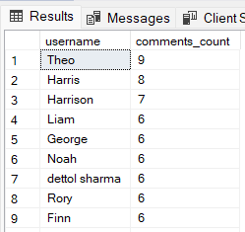
QUERY 10
Q. Find the users who have commented on the most posts
This query identifies the top 10 users who have commented on the highest number of posts. It's useful for recognizing highly engaged users in terms of comments.
ashishsrivastav1999@gmail.com

Slide 14
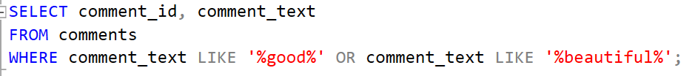
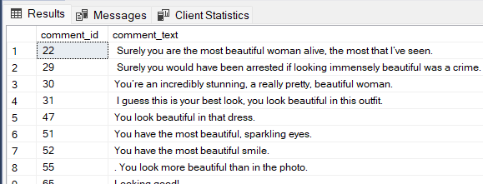
QUERY 11
Q. Any specific word in comment
This query searches for comments containing specific words like "good" or "beautiful." It's useful for finding and categorizing comments with particular keywords.
ashishsrivastav1999@gmail.com

Slide 15
THE END
Project By – Ashish Kumar Srivastava
Email – ashishsrivastav1999@gmail.com
LinkedIn - www.linkedin.com/in/ashish-srivastava-22850a25a
Github - https://github.com/Ashish-kr-Srivastava

